Slide 1
CS433 Parallel and Distributed Computing
Lecture 5 GPU Architecture
Prof. Xiaoyao Liang
2020/9/30

Slide 2
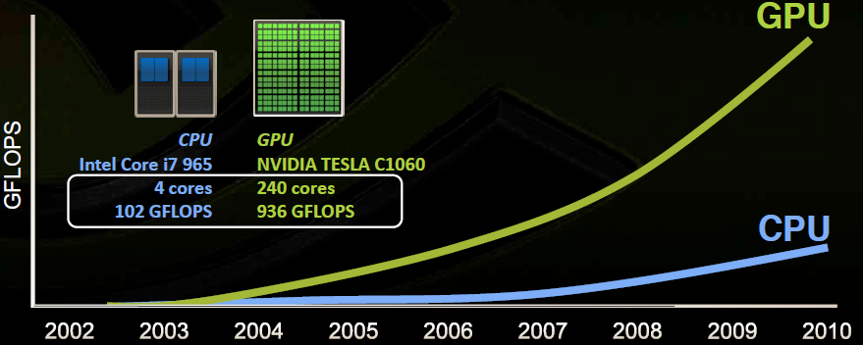
GPU Scaling
A quiet revolution and potential build-up
Calculation: 20 TFLOPS vs. 100 GFLOPS
Memory Bandwidth: 1.6TB/s vs. 16 GB/s
Every PC, phone, pad has GPU now

Slide 3
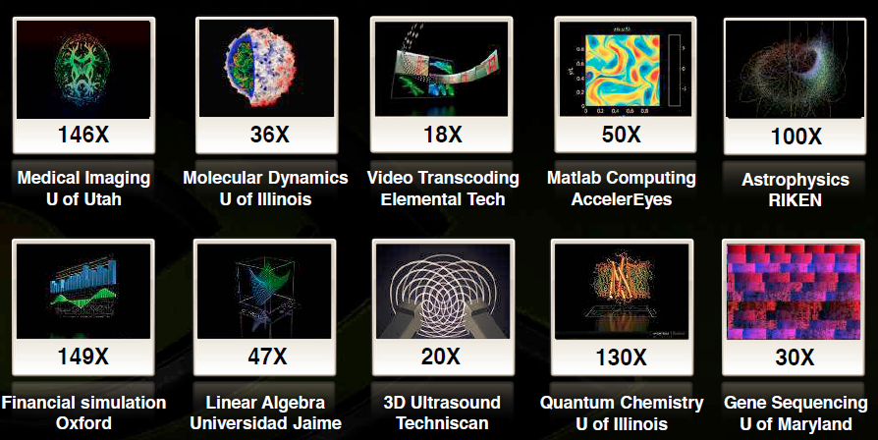
GPU Speedup
GeForce 8800 GTX vs. 2.2GHz Opteron 248
• 10´ speedup in a kernel is typical, as long as the kernel can occupy enough parallel threads
• 25´ to 400´ speedup if the function’s data requirements and control flow suit the GPU and the application is optimized

Slide 4
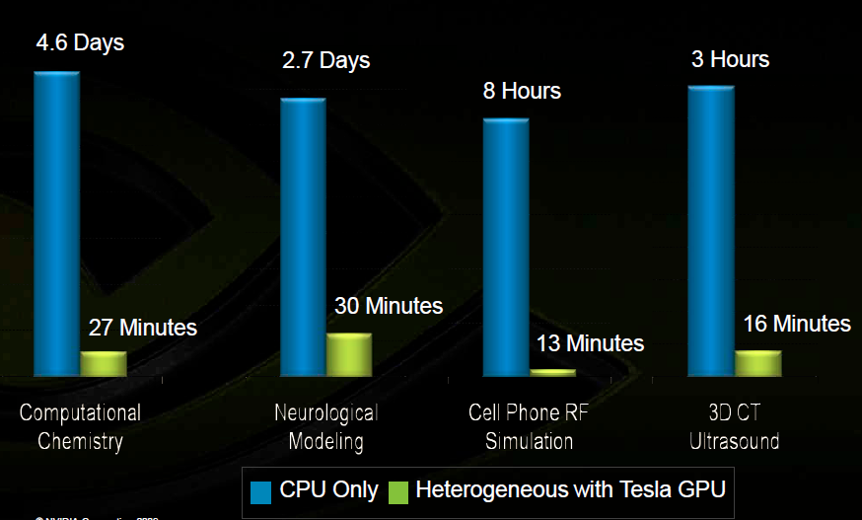
GPU Speedup

Slide 5
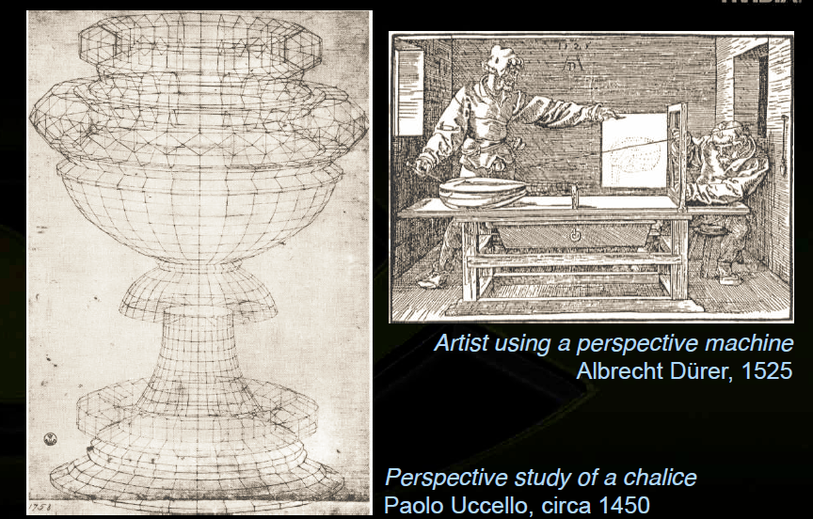
Early Graphic Hardware

Slide 6
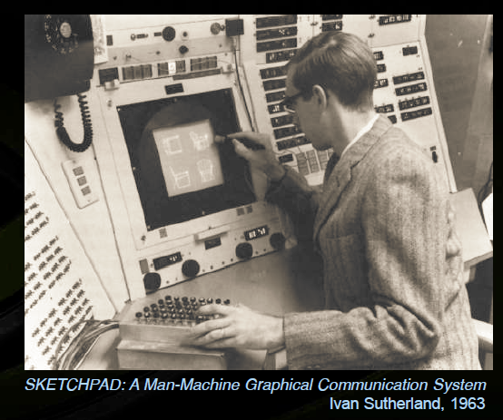
Early Electronic Machine

Slide 7
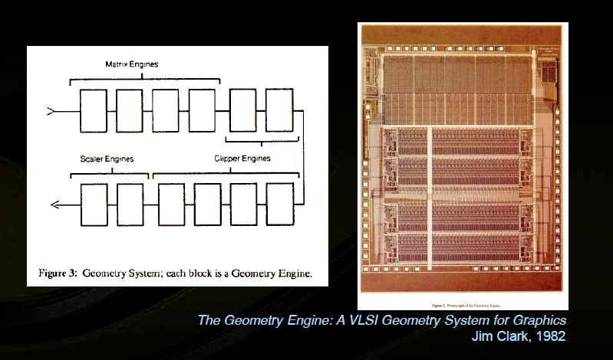
Early Graphic Chip

Slide 8
Graphic Pipeline
• Sequence of operations to generate an image
using object-order processing
Primitives processed one-at-a-time
Software pipeline: e.g. Renderman
• High-quality and efficiency for large scenes
Hardware pipeline: e.g. graphics accelerators
• Will cover algorithms of modern hardware pipeline
But evolve drastically every few years
We will only look at triangles

Slide 9
Graphic Pipeline
• Handles only simple primitives by design
Points, lines, triangles, quads (as two triangles)
Efficient algorithm
• Complex primitives by tessellation
Complex curves: tessellate into line strips
Curves surfaces: tessellate into triangle meshes
• “pipeline” name derives from architecture design
Sequences of stages with defined input/output
Easy-to-optimize, modular design

Slide 10
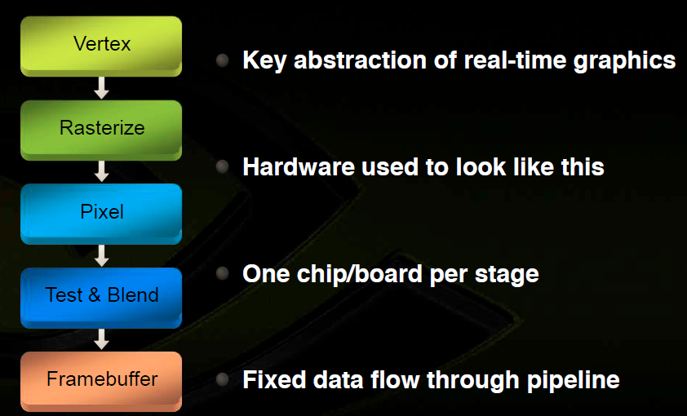
Graphic Pipeline

Slide 11
Pipeline Stages
• Vertex processing
Input: vertex data (position, normal, color, etc.)
Output: transformed vertices in homogeneous canonical view-volume, colors, etc.
Applies transformation from object-space to clip-space
Passes along material and shading data
• Clipping and rasterization
Turns sets of vertices into primitives and fills them in
Output: set of fragments with interpolated data

Slide 12
Pipeline Stages
• Fragment processing
Output: final color and depth
Traditionally mostly for texture lookups
• Lighting was computed for each vertex
Today, computes lighting per-pixel
• Frame buffer processing
Output: final picture
Hidden surface elimination
Compositing via alpha-blending

Slide 13
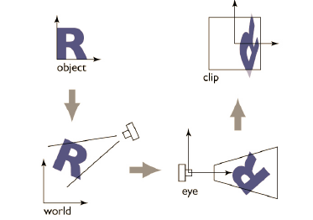
Vertex Processing

Slide 14
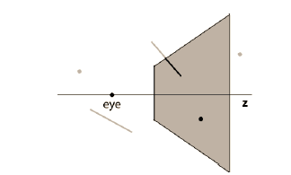
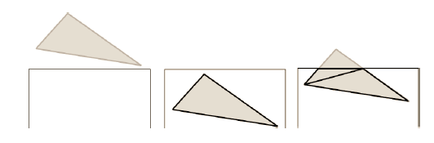
Clipping

Slide 15
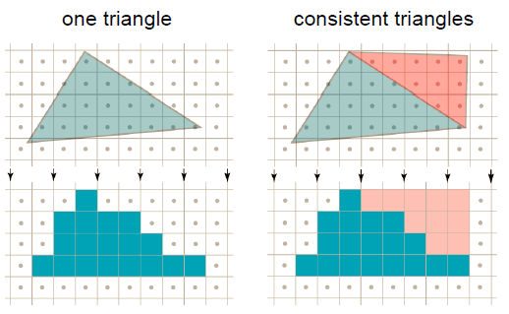
Rasterization

Slide 16
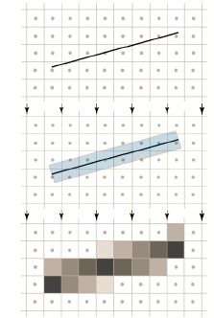
Anti-Aliasing

Slide 17
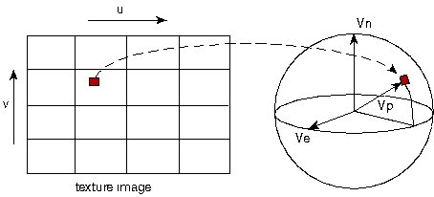

Texture

Slide 18
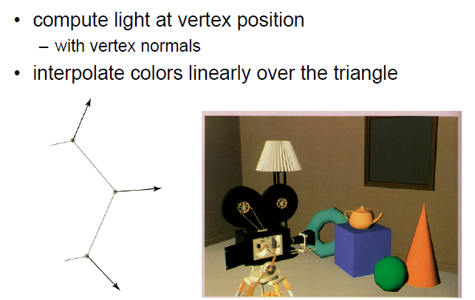
Gouraud Shading

Slide 19
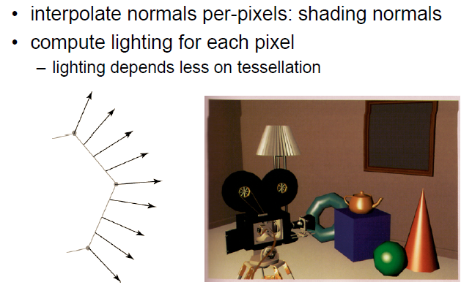
Phong Shading

Slide 20

Alpha Blending

Slide 21
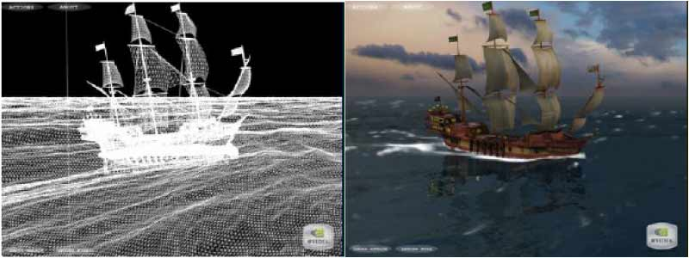
Wireframe

Slide 22
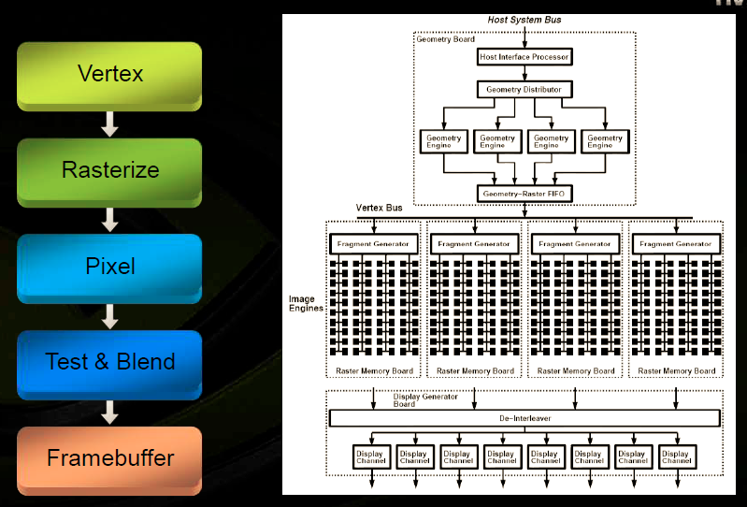
SGI Reality Engine (1997)

Slide 23
Graphic Pipeline Characteristic
• Simple algorithms can be mapped to hardware
• High performance using on-chip parallel execution
highly parallel algorithms
memory access tends to be coherent

Slide 24
Graphic Pipeline Characteristic
• Multiple arithmetic units
NVidia Geforce 7800: 8 vertex units, 24 pixel units
• Very small caches
not needed since memory access are very coherent
• Fast memory architecture
needed for color/z-buffer traffic
• Restricted memory access patterns
read-modify-write
• Easy to make fast: this is what Intel would love!

Slide 25
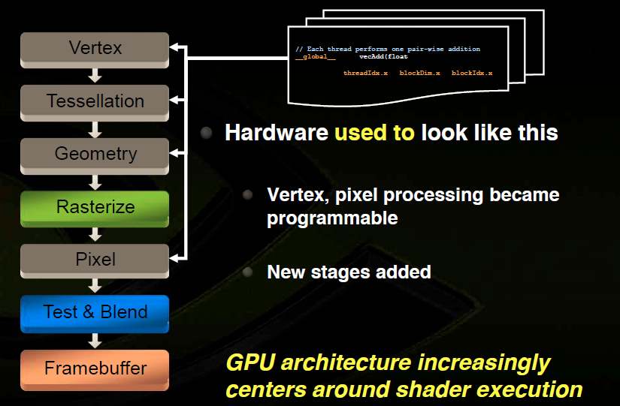
Programmable Shader

Slide 26
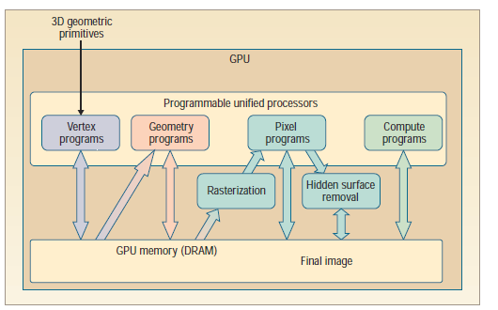
Programmable Shader

Slide 27
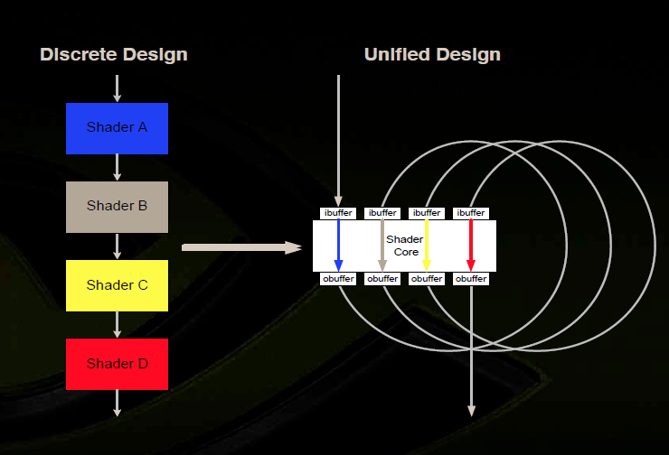
Unified Shader

Slide 28
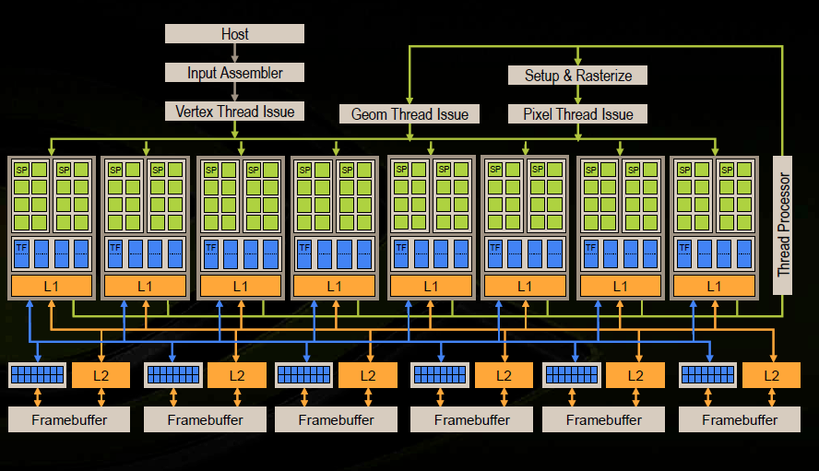
GeForce 8

Slide 29
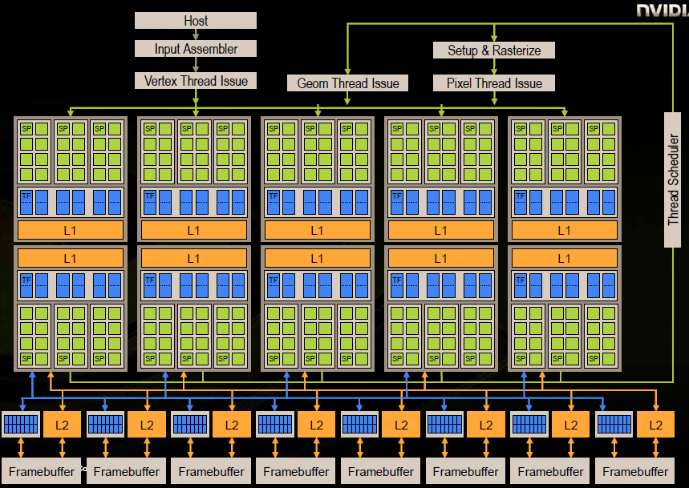
GT200

Slide 30
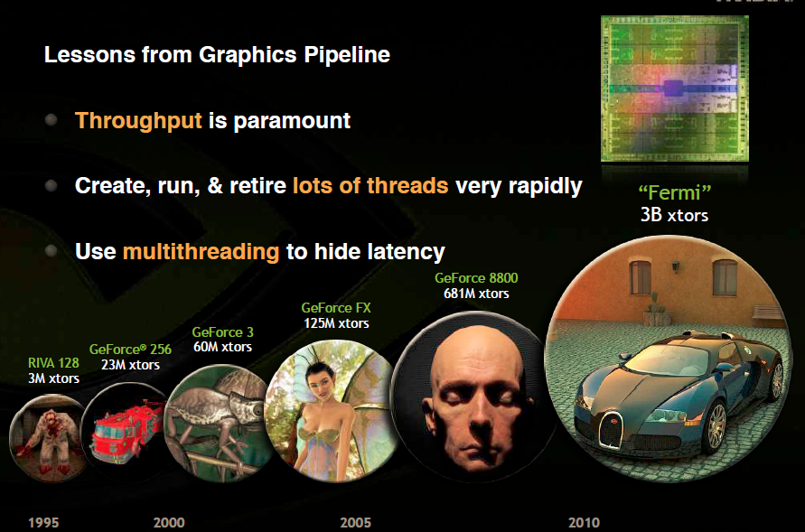
GPU Evolution

Slide 31
Moore’s Law
Computers no longer get faster, just wider
You must re-think your algorithms to be parallel !
Data-parallel computing is most scalable solution

Slide 32
GPGPU 1.0
GPU Computing 1.0: compute pretending to be graphics
Disguise data as textures or geometry
Disguise algorithm as render passes
Trick graphics pipeline into doing your computation!
Term GPGPU coined by Mark Harris

Slide 33
GPU Grows Fast
GPUs get progressively more capable
Fixed-function ! register combiners ! shaders
fp32 pixel hardware greatly extends reach
Algorithms get more sophisticated
Cellular automata ! PDE solvers ! ray tracing
Clever graphics tricks
High-level shading languages emerge

Slide 34
GPGPU 2.0
GPU Computing 2.0: direct compute
Program GPU directly, no graphics-based restrictions
GPU Computing supplants graphics-based GPGPU
November 2006: NVIDIA introduces CUDA

Slide 35

GPGPU 3.0
GPU Computing 3.0: an emerging ecosystem
Hardware & product lines
Algorithmic sophistication
Cross-platform standards
Education & research
Consumer applications
High-level languages

Slide 36
GPGPU 4.0
GPU Computing 4.0: the ultimate computing platform
Core of the modern computer system in data center
Default for AI, Graphic, VR, AR, Scientific etc
General computing plus special optimization
Leading the technology node
Scalable, virtualized, MIG
Hotspot in frontend research

Slide 37
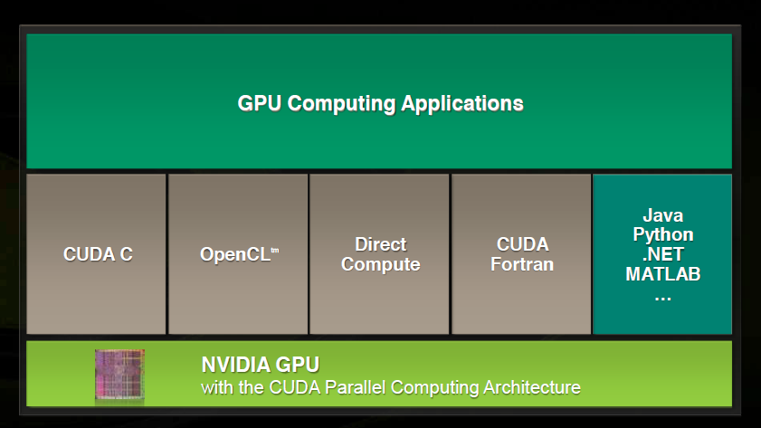
GPGPU Platforms

Slide 38
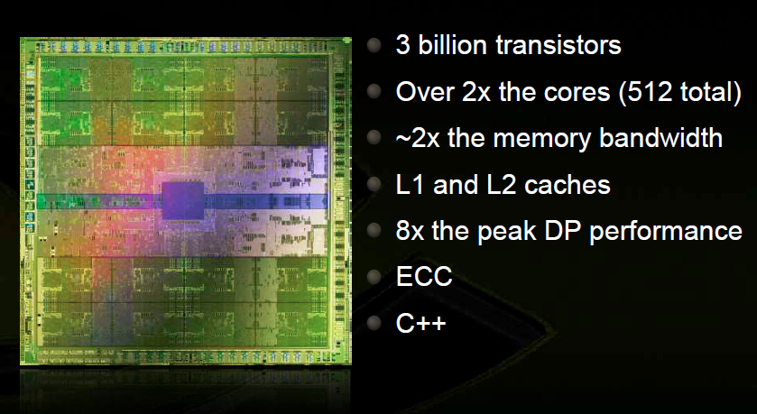
Fermi

Slide 39
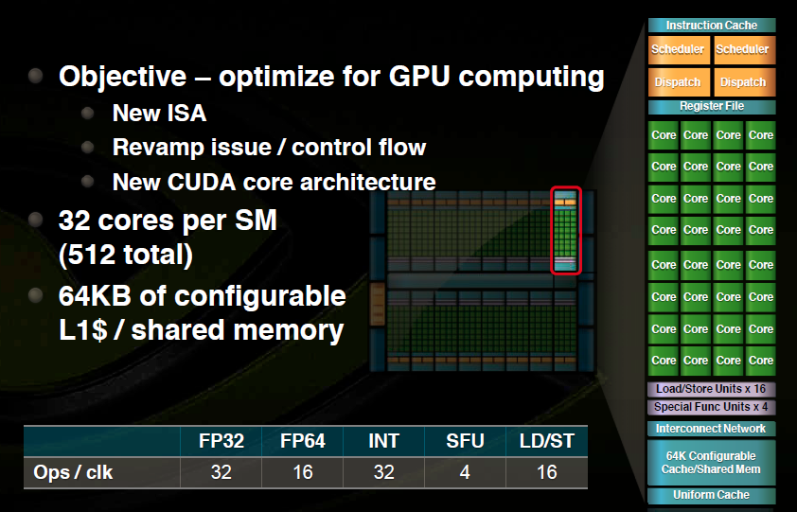
Fermi Architecture

Slide 40
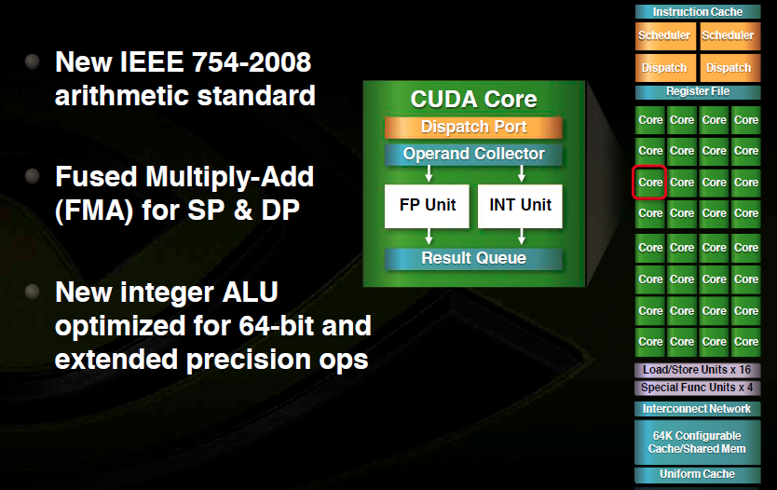
SM Architecture

Slide 41
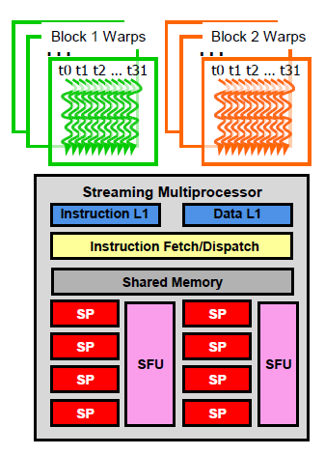
SM Architecture
• Each Thread Blocks is divided in 32-
thread Warps
This is an implementation decision, not
part of the CUDA programming model
• Warps are scheduling units in SM
• If 3 blocks are assigned to an SM and
each Block has 256 threads, how many
Warps are there in an SM?
Each Block is divided into 256/32 = 8 Warps
There are 8 * 3 = 24 Warps
At any point in time, only one of the 24 Warps will be selected for instruction fetch and execution.

Slide 42
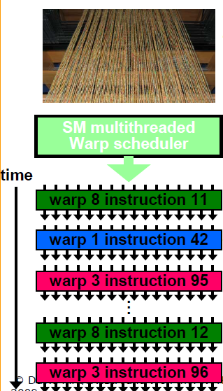
SM Architecture
• SM hardware implements zero overhead Warp scheduling
Warps whose next instruction has its operands ready for consumption are eligible for execution
Eligible Warps are selected for execution on a prioritized scheduling policy
All threads in a Warp execute the same instruction when selected
• 4 clock cycles needed to dispatch the
same instruction for all threads in a
Warp
If one global memory access is needed for every 4 instructions
A minimal of 13 Warps are needed to fully tolerate 200-cycle memory latency

Slide 43
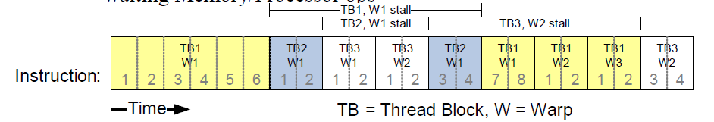
SM Architecture
• All register operands of all instructions in the Instruction Buffer are scoreboarded
Instruction becomes ready after the needed values are deposited
Prevents hazards
Cleared instructions are eligible for issue
• Decoupled Memory/Processor pipelines
Any thread can continue to issue instructions until scoreboarding prevents issue
Allows Memory/Processor ops to proceed in shadow of other waiting Memory/Processor ops

Slide 44
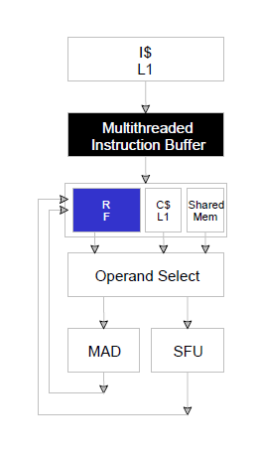
SM Architecture
• Register File (RF)
32 KB (8K entries) for each SM
Single read/write port, heavily banked
• TEX pipe can also read/write RF
• Load/Store pipe can also read/write RF

Slide 45
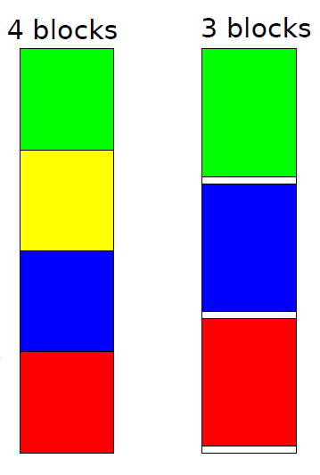
SM Architecture
This is an implementation decision, not part of CUDA
Registers are dynamically partitioned across all blocks/warps assigned to the SM
Once assigned to a block, the register is NOT accessible by threads in other warps
Each thread in the same block only access registers assigned to itself

Slide 46
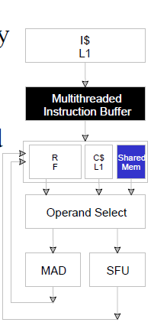
SM Architecture
• Each SM has 16 KB of Shared Memory
16 banks of 32bit words
• CUDA uses Shared Memory as shared storage visible to all threads in a thread block
read and write access
• Not used explicitly for pixel shader
programs
we dislike pixels talking to each other

Slide 47
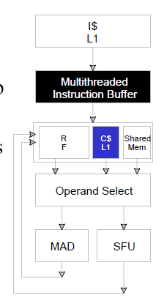
SM Architecture
• Immediate address constants/cache
• Indexed address constants/cache
• Constants stored in DRAM, and cached on chip
1 L1 per SM
• A constant value can be broadcast to all threads in a Warp
Extremely efficient way of accessing a value that is common for all threads in a block!

Slide 48
Bank Conflict
• Shared memory is as fast as registers if there are no bank conflicts
• The fast case:
If all threads access different banks, there is no bank conflict
If all threads access the identical address, there is no bank conflict (broadcast)
• The slow case:
Bank Conflict: multiple threads access the same bank
Must serialize the accesses
Cost = max # of simultaneous accesses to a single bank

Slide 49
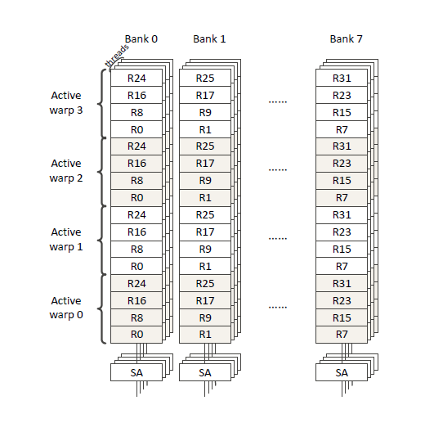
Bank Conflict

Slide 50
CPU & GPU Architecture Outline
RF
CPU
L1
L2
RF
GPU
L1

Slide 51
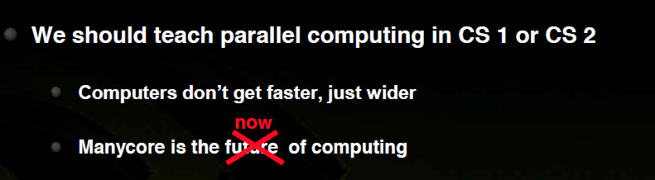
Final Thought

Slide 52
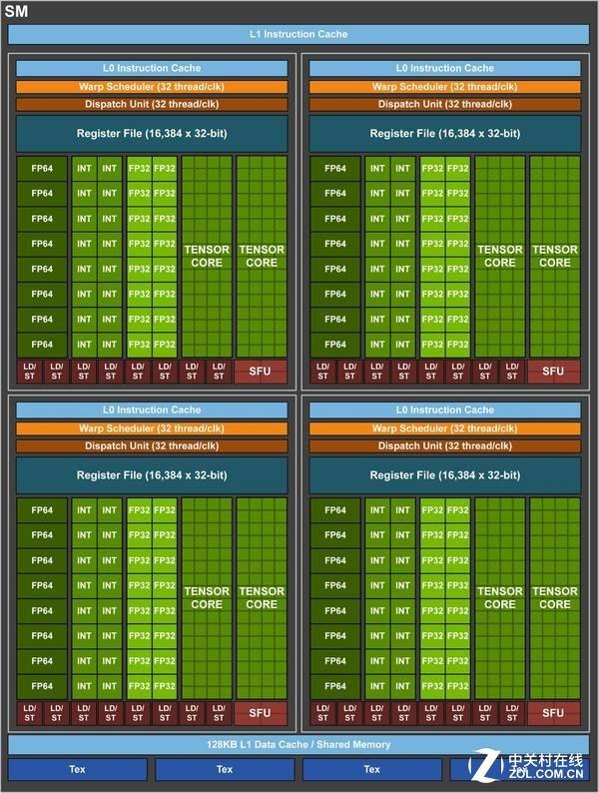
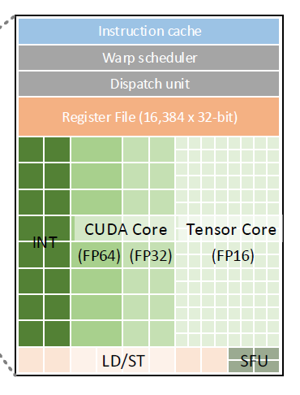
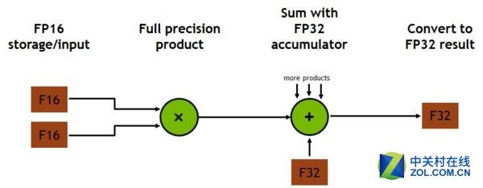
NVIDIA Volta

Slide 53
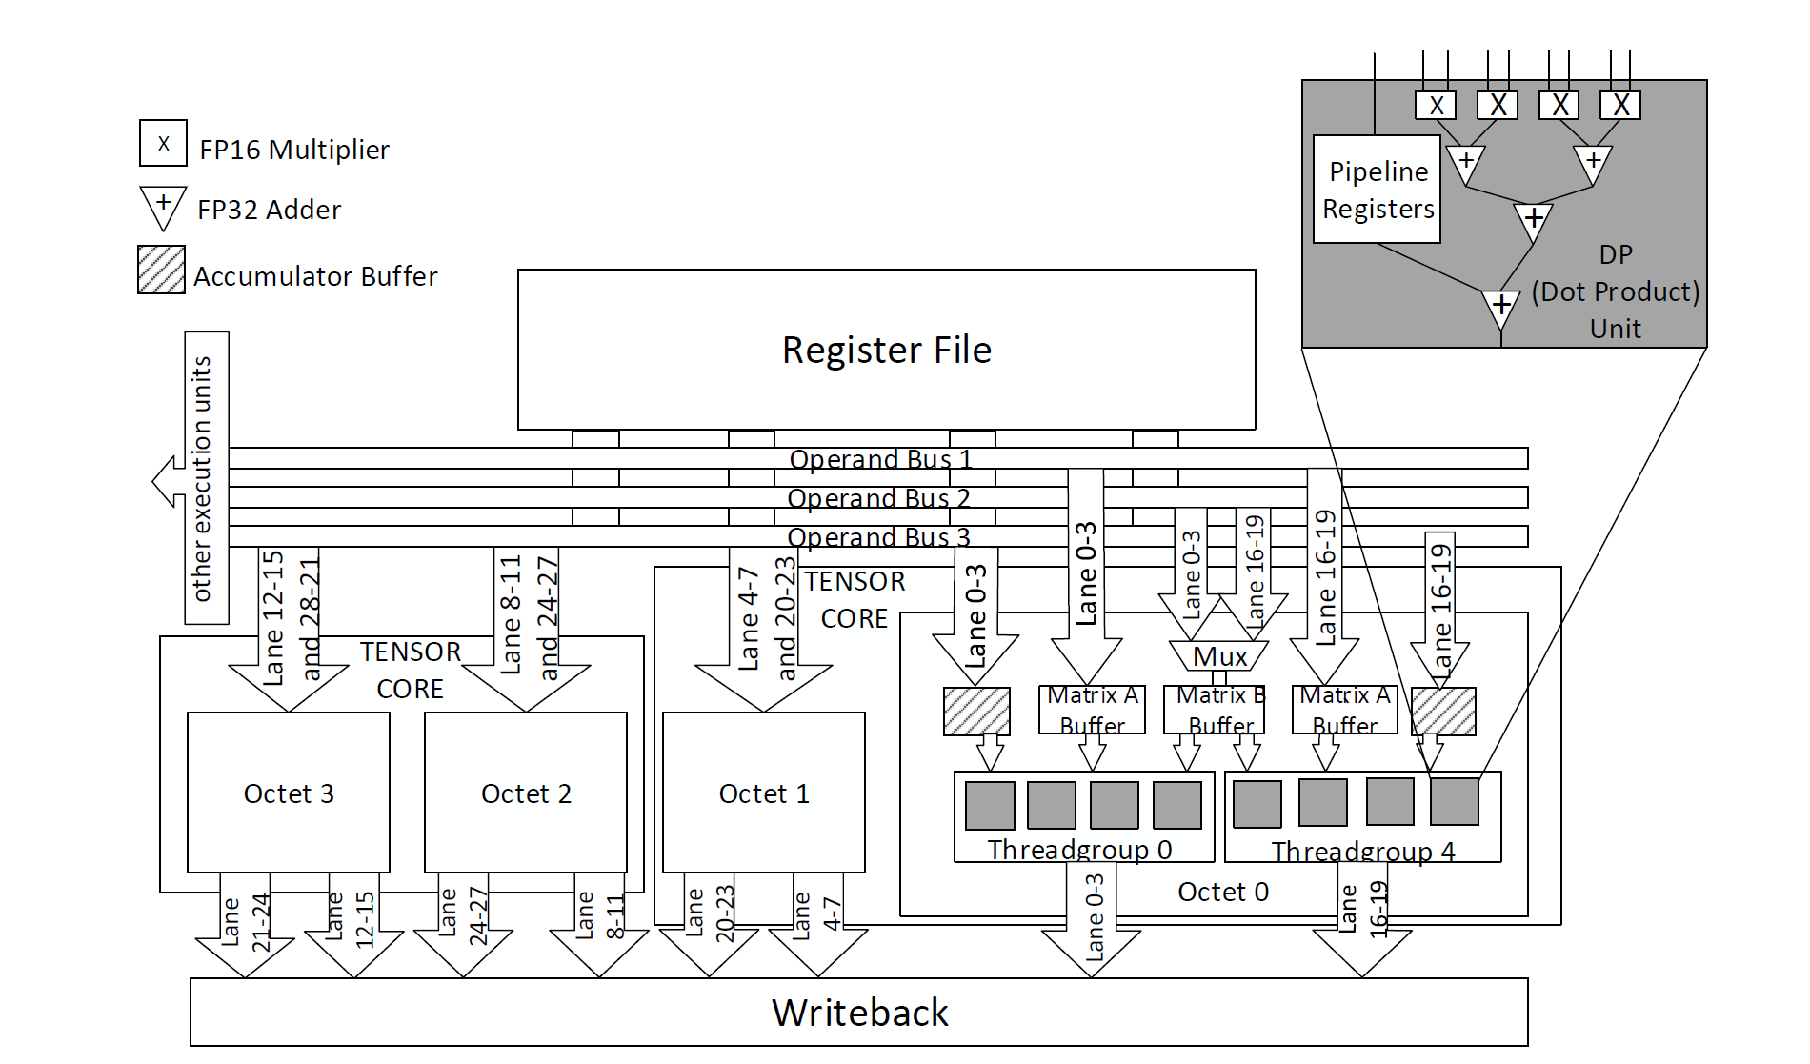
Tensor Core

